Slide 1
CPU Scheduling
Week 4: CS 3100
Supplemental Slides & Notes for Chapter 6

Slide 2
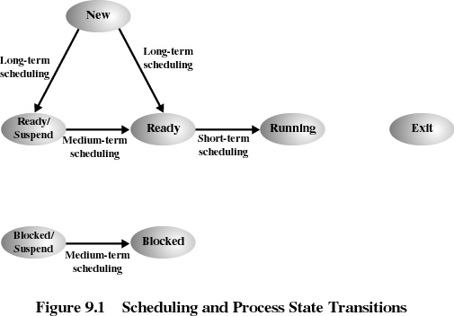
Notes:
Remember the schedulers we covered in Chapter 3? Here is an overview of which scheduler is responsible for each process context switch.

Slide 3
CPU SCHEDULING
The Short Term Scheduler
Selects from among the processes in memory that are ready to execute, and allocates the CPU to one of them
CPU scheduling decisions may take place when a process:
  1. Switches from running to waiting state (non-preemptive)
  2. Switches from running to ready state (preemptive)
  3. Switches from waiting to ready (preemptive)
  4. Terminates (non-preemptive)

Slide 4
Scheduling can be…
Non-preemptive
  Once a process is in the running state, it will continue until it terminates or blocks itself for I/O
Preemptive
  Currently running process may be interrupted and moved to the Ready state by the operating system
  Allows for better service since any one process cannot monopolize the processor for very long
Priority Based
  Scheduler will always choose a process of higher priority over one of lower priority
  Usually has multiple ready queues to represent each level of priority

Slide 5
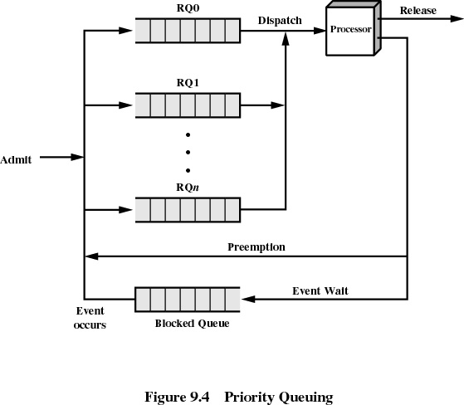
Notes:
This is an example of multiple priority level queues that the short term scheduler uses. We’ll use this concept for the Multi-Level Feedback Queue (at the end of slides).

Slide 6
Short-Term Scheduling Criteria
User-oriented
  Response (minimize Wait Time)
    Elapsed time between the submission of a request until there is output.
    Wait Time: Is the actual finish time of the process minus its total running time minus its actual (ready) arrival time.
System-oriented (maximize Turnaround Time)
    Effective and efficient utilization of the processor
    Turnaround Time: Is the actual finish time of the process minus its actual (ready) arrival time.

Slide 7
Process Scheduling Example
Consider the set of processes below that show up in the order A,B,C,D,E. Highest priority is 3, lowest priority is 1. Calculate the average turnaround and waiting times for the set of jobs for each of the scheduling algorithms on the next slides.
Process | Arrival Time | CPU Time | Priority
A | 0 | 190 | 1
B | 20 | 280 | 3
C | 40 | 80 | 2
D | 60 | 400 | 1
E | 80 | 250 | 3
Notes:
Waiting Time is the actual time a process waits before it STARTS to Run (minus the earliest arrival time it could have started). The wait time gives the user a perceived notion that the process is executing. Turnaround Time is the total time it takes a process to FINISH (minus the actual time it arrived).

Slide 8
First-Come-First-Served
(FCFS)
5
Each process joins the Ready queue at various times.
When the current process ceases to execute, the oldest process in the Ready queue is selected
0
10
15
20
1
2
3
4
5

Slide 9
First-Come-First-Served
(FCFS)
Favors CPU-bound processes
  I/O processes have to wait until CPU-bound process completes
A short process may have to wait a very long time before it can execute
Waiting: (190-190-0) + (470-280-20) +
(550-80-40) + (950-400-60) + (1200-250-80) / 5 = 392 ms
Turnaround: (190-0) + (470-20) + (550-40) + (950-60) + (1200-80) / 5 = 632 ms
Notes:
Wait Time. Process A doesn’t have to wait any time for the CPU. The soonest process B could have ran would have been on cycle 20, but it doesn’t get to start until cycle 190 (until after process A is complete – the rule of FCFS). Therefore the wait time for process B is 170. Keep doing this for all processes and divide by the total # of processes (in this case, 5). Turnaround Time: Is the actual finish time of the process minus the arrival time of the process. In this case, process A ended at 190 and started at 0. Process B ended at 470 and arrived at 20, etc….
FCFS is not a good scheduling algorithm (as noted in the above slide). Keep in mind that the OS will continuously evaluate ALL the scheduling algorithms we will discuss and pick the best one. It will adjust it’s scheduling algorithm based on workload of the system. SO, there actually may be a time when it would select FCFS as the best algorithm – although it’s highly unlikely.

Slide 10
CPU SCHEDULING
PREEMPTIVE ALGORITHMS:
Break the CPU away from the currently executing process when a higher priority process is ready.
Can be applied to both Shortest Job First or to Priority scheduling (discussed next).
Avoids "hogging" of the CPU
On time sharing machines, this type of scheme is required because the CPU must be protected from a run-away low priority process.
Give short jobs a higher priority – perceived response time is thus better.
What are average queueing and residence times? Compare with FCFS.

Slide 11
Shortest Job First (Shortest Process Next)
0
5
10
15
20
Preemptive policy – if another process in the queue is shorter. Not priority Based.
Process with shortest expected processing time is selected next, regardless of priority.
Short process jumps ahead of longer processes
1
2
3
4
5
Notes:
This requires knowledge of the length of the next CPU Request. SJF is frequently used in Long Term Scheduling, where we have this luxury.

Slide 12

Shortest Job First
  Optimal for minimizing queuing time, but difficult to implement. Tries to predict the process to schedule based on previous history.
Still possibility of starvation for longer processes.
Waiting: (270-190-0) + (800-280-20) + (120-80-40) + (1200-400-60) + (520-250-80) / 5 =
316 ms
Turnaround: (270 -0) + (800-20) + (120-40) + (1200-60) + (520-80) / 5 = 556 ms
Notes:
A runs 40. At Cycle 40, C becomes the shortest job. C runs to 120 and finishes.

Slide 13
Priority Scheduling
Preemptive version of shortest job first (process next) policy
Priorities take precedence, and some processes may suffer starvation.
For simplicity, assume all processes arrive time 0. Priority 3 highest.
In a tied priority, make an assumption…assuming E&B,C,A&D
E runs 250, CPU 250
B runs 280, CPU 530
C runs 80, CPU 610
A runs 190, CPU 800
D runs 400, CPU 1200
Waiting: (800-190) + (530-280) + (610-80) + (1200-400) + (250-250) / 5 = 438 ms
Turnaround: (800) + (530) + (610) + (1200) + (250) / 5 =
678 ms
0
5
10
15
20
1
2
3
4
5

Slide 14
Round-Robin
Uses preemption based on a clock (timeslice)
An amount of time is determined that allows each process to use the processor for that length of time
0
5
10
15
20
1
2
3
4
5
Notes:
A timeslice is an allocated number of CPU cycles given to a process.

Slide 15
Round-Robin
Clock interrupt is generated at periodic intervals
When an interrupt occurs, the currently running process is placed in the ready queue
  Next ready job is selected. It is NOT Priority Based.
Known as time slicing (This example uses 100ms timeslices)
A runs 100, 90 Left, CPU = 100,B runs 100, 180 Left, CPU = 200, C runs 80, C Finishes 280
D runs 100, 300 Left, CPU = 380,E runs 100, 150 Left, CPU = 480, A runs 90, A Finishes 570
B runs 100, 80 Left, CPU 670,D runs 100, 200 Left, CPU 770,E runs 100, 50 Left, CPU = 870
B runs 80, B Finishes 950,D runs 100, 100 Left, CPU 1050, E runs 50, E Finishes 1100, CPU = 1100, D Finishes 1200
Waiting: (570-190) + (950-280-20) + (280-80-40) + (1200-400-60) + (1100-250-80) / 5 =
540 ms
Turnaround: 570 + (950-20) + (280-40) + (1200-60) + (1100-80) / 5 = 780 ms

Slide 16
Round-Robin
Choosing a time quantum
  Too short - inordinate fraction of the time is spent in context switches.
  Too long - reschedule latency is too great. If many processes want the CPU, then it's a long time before a particular process can get the CPU. This then acts like FCFS.
  Adjust so most processes won't use their slice. As processors have become faster, this is less of an issue.
5: CPU-Scheduling

Slide 17

CPU SCHEDULING
MULTI-LEVEL QUEUES:
Each queue has its scheduling algorithm.
Then some other algorithm (perhaps priority based) arbitrates between queues.
Can use feedback to move between queues
Method is complex but flexible.
For example, could separate system processes, interactive, batch, favored, unfavored processes

Slide 18
Multi-Level Queues
0
5
10
15
20
Penalizes jobs that have been running longer by lowering their priority
Doesn’t matter remaining time process still needs to execute
Even though priority is lowered, the next time around the remaining process gets a double timeslice.
1
2
3
4
5

Slide 19
Multi-Level Queues
Is like Round Robin, but is Priority Based
Example assumes Priority E&B, then C, then A&D
*NOTE: For simplicity, all processes are arrival time zero.
Time Quantum set at 100ms.
E runs 100, 150 Left, Priority 2 (q=200), CPU 100
B runs 100, 180 Left, Priority 2 (q=200), CPU 200
C runs 80, C FINISHES 280, CPU 280
E runs 150, E FINISHES 430, CPU 430
B runs 180, B FINISHES 610, CPU 610
A runs 100, 90 Left, CPU 710
D runs 100, 300 Left, CPU 810
A runs 90, A FINISHES 900, CPU 900
D FINISHES 1200
Waiting: (900-190) + (610-280) + (280-80) + (1200-400) + (430-250) / 5 = 444 ms
Turnaround: 900 + 610 + 280 + 1200 + 430 + / 5 = 684 ms*
Notes:
Note: Since Priority 3 is the highest priority, we could evaluate B&E or E&B. Also, for priority 1, we could evaluate D&A or A&D, so you got to chose one or the other…or else you’ll be doing this all day.

Slide 20

CPU SCHEDULING
How do we decide which algorithm is best for a particular environment?
Deterministic modeling – takes a particular predetermined workload and defines the performance of each algorithm for that workload.
Queuing models.

Slide 21
CPU SCHEDULING
(other considerations)
Multiple Processor Scheduling:
Different rules for homogeneous or heterogeneous processors.
  Each processor can schedule from a common ready queue (equal machines) or can use a master slave arrangement.
Load sharing in the distribution of work, such that all processors have an equal amount to do.
Real Time Scheduling:
Hard real-time systems – required to complete a critical task within a guaranteed amount of time.
Soft real-time computing – requires that critical processes receive priority over less fortunate ones.

Slide 22

CPU SCHEDULING
(other considerations)
Algorithms: time-sharing and real-time
Time-sharing
  Prioritized credit-based – process with most credits is scheduled next
  Credit subtracted when timer interrupt occurs
  When credit = 0, another process chosen
  When all processes have credit = 0, recrediting occurs
    Based on factors including priority and history
Real-time
  Soft real-time
  Posix.1b compliant – two classes
    FCFS and RR
    Highest priority process runs first

